Slide 1
Chapter 20 Presentation
Team Lanai: Niraj Bhakta, Amanda Homeyer, Richard Deleon, Sarai Camargo, McKay Wilkerson

Slide 2
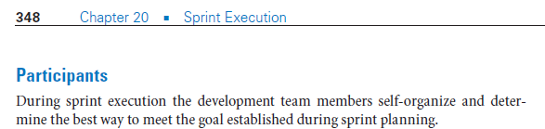
Sprint Goal: Meet with Daniel to Determine Sprint Execution

Slide 3
Developing Sprint Plan
Meeting with Daniel
Backlog Items
Hardcode Metrics
Display Metrics
Create Presentation
Execute Presentation

Slide 4
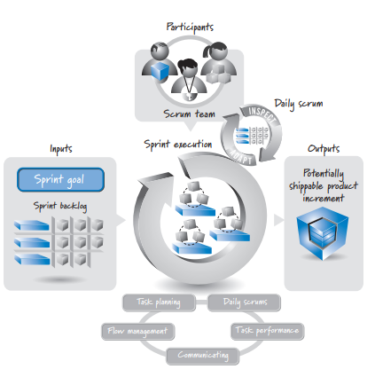
Sprint execution process includes sprint goal and sprint backlog that were generated during sprint planning.

Slide 5
Organizing Task Work
Collectively worked on presentation
Collectively met with Daniel
Niraj collected metrics
Amanda pushed UML diagrams to GitHub
McKay pushed presentations to GitHub

Slide 6
Next Week’s Sprint Goals:
Chapter 21 Presentation
Metrics Code Collaboration

